Slide 1



BIOT 2018
hainge search engine @FuturICT 2.0 Challenge
Team: Andreas Kuster, Irina Lang, Karin Holzhauser,
Mark Straub, Sandra Lozano, Tuân Pham Huu
« The attempt to break the monopoly »

Slide 2
chainge to a community consensus search engine
We want to
Worldwide web of information
embrace the variety of opinions by providing access to unscencored information
provide an alternative to money driven search engines
offer a clear and comprehensive evaluation and ranking process of websites
build a community to increase reliability, quality and diversity of information
create an blockchain based ranking engine
$$$

Slide 3
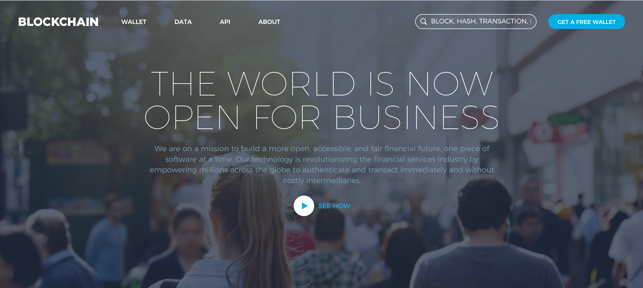
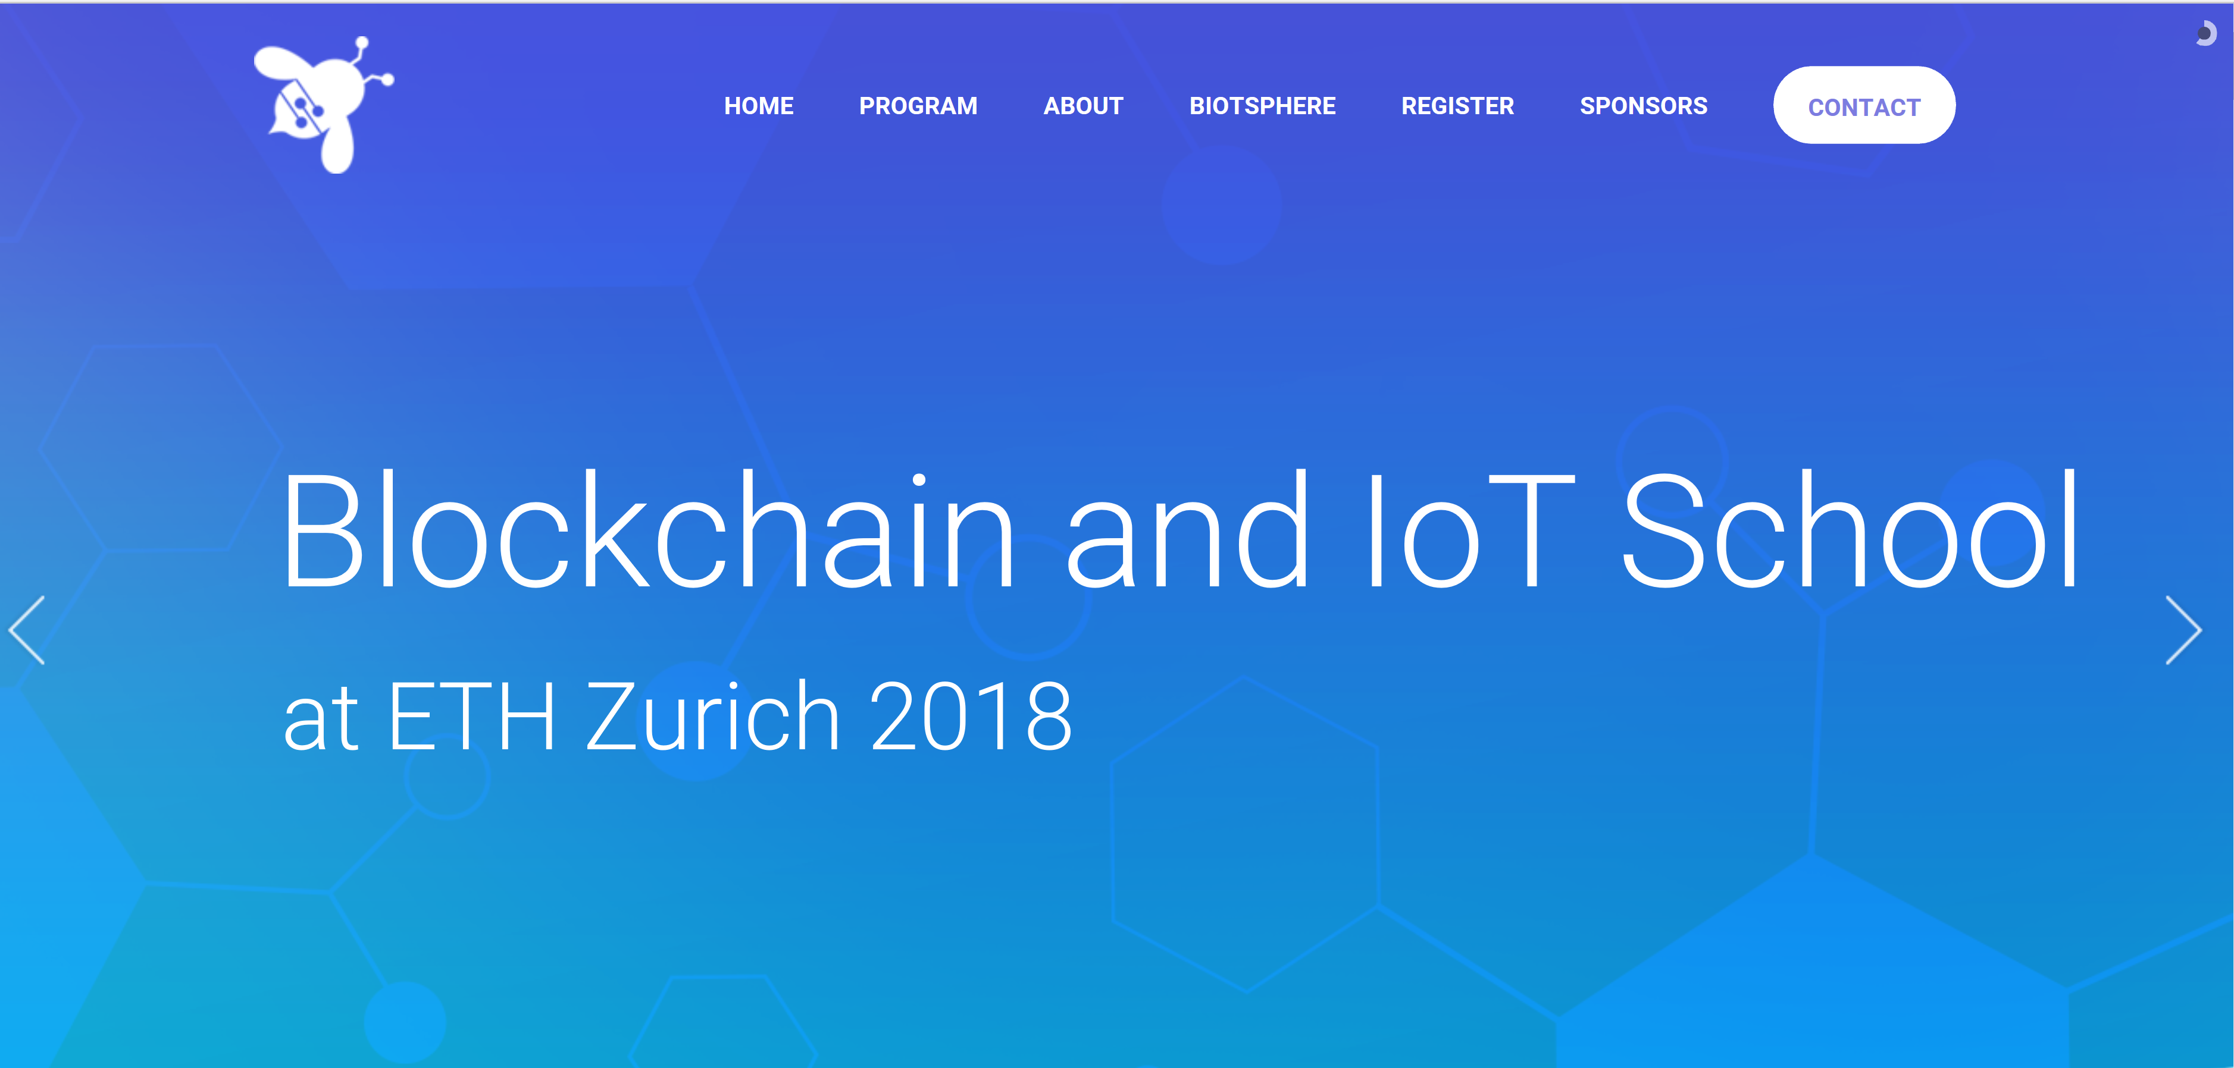

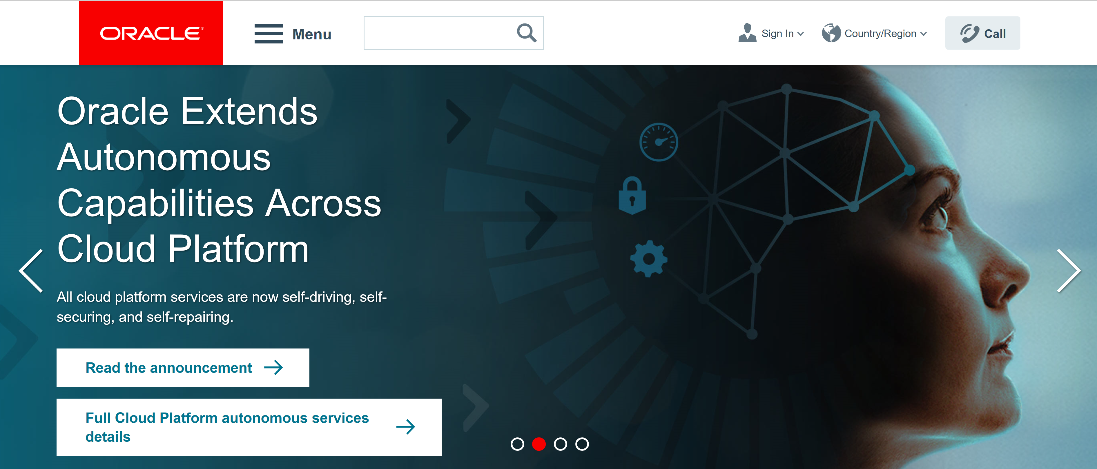
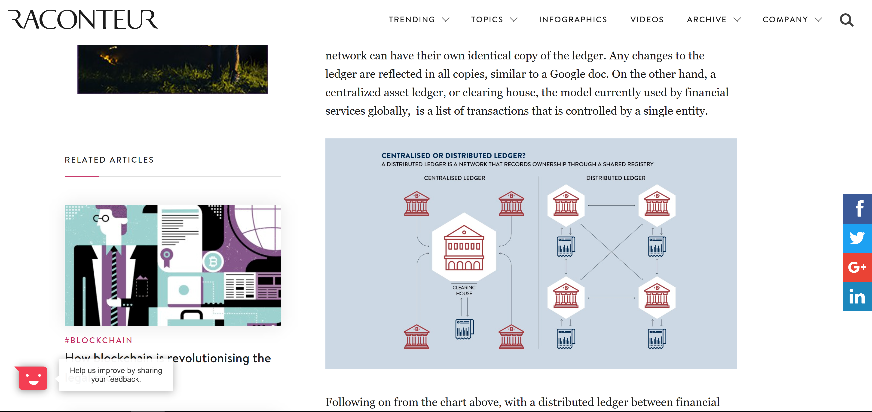



A token based approach to disrupt the information selection monopoly"
Current Ranking
New Ranking
E
E
Determines scatter of EVAL
E
Updated Ranking
TRUST Token
Trust Level
CYCLE
EVAL Token
pos
neg
Website Evaluation

Slide 4

Gain critical mass with efficient mechanism and easy onboarding
Eval Token
Trust Token
Purpose: evaluation of web site contents
Mechanism: Used from users to fill or reduce webpage ranking wallets
Minimum start amount per registered Chainge participant for each cycle
Increase of tokens is based on consensus
No accumulation of tokens – tokens expire after the cycle
Balance represents current Website rating
Purpose: reflects user's ranking credibility
Mechanism: Tool of the Chainge Application to incentivice users for their rankings, Influences Eval Token Distribution
Fixed minimum amount of tokens
Trust status changes according trust level statistic
Upper boundary to prohibit singular dominance
evaluating
System calculates trust
Updated trust triggers eval token scatter
Start of next round
Possible Risks & Bugs
Initial token financing
Need of a first mover community
Usual bad guys and guess who?
Technology Roadmap
AI to detect fraud or robots
Mining of Tokens through users (e.g. coinhive)
Algorithms to optimize Token-calculation and distribution

